Slide 1
iChappal
An AI powered Fitness App..

Slide 2
Introduction

Slide 3
Technology Highlights
Android Mobile App
Web App with TensotFlow.JS and dashboard
Chat Bot – Alexa
Kafka
Spark
Firebase DB
Website serverless deployment

Slide 4




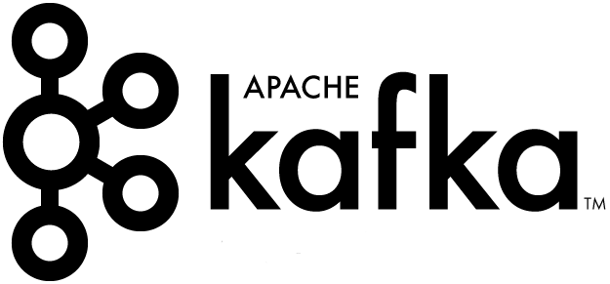



Architecture diagram
Alexa Skill Interface
AWS Lambda
S3 Bucket
HTML, CSS, JavaScript, Images, etc.
TensorFlow.Js
REST API
Web App in Browser
Kafka REST API
Mobile App
Users

Slide 5
Demo
Mobile App
Web App http://amplify-angular-app.s3-website-us-east-1.amazonaws.com/
Chat Bot - Alexa

